Slide 1
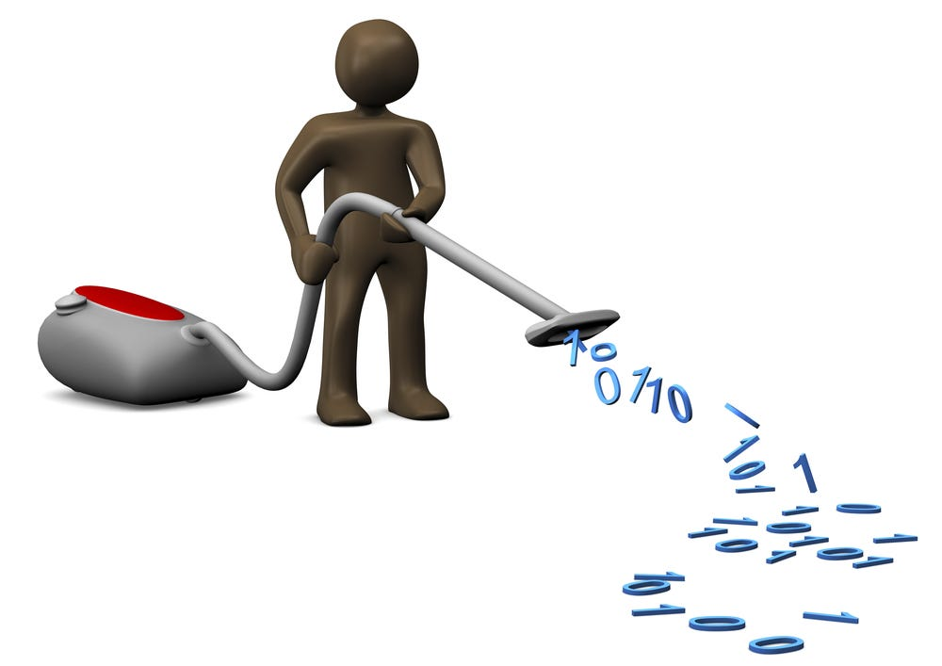

Data cleaning and exploration 1
BIOL90041
Week 2
Dr. Kristoffer Wild

Slide 2
Todays Learning objectives
Finding your data…
How do we do it?
Then how do we save it?
Viewing and inspecting your data
functions to look at data once imported
Protocol for data exploration from from Zuur et al., 2010
What is quarto and it’s functionality

Slide 3
So you want to be a data scientist…

Slide 4
How will you spend your time?

Slide 5
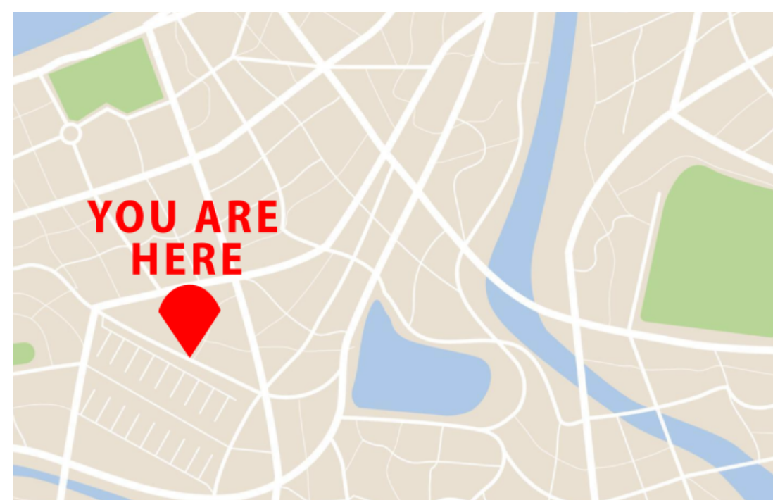
Working Directory
Most of the time, you won’t generate data in R — you’ll import it from external files
Before importing data, you need to understand where R is “looking” from
This location is called your working directory
The working directory is your R console’s current vantage point on your files
Notes:
Most of the time you will not be generating data in R but will be importing data from external files.
Before we can read in data, you need to know from what vantage point your R console is looking.
This view point is the working directory.

Slide 6
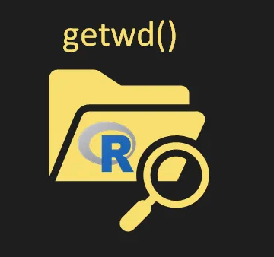
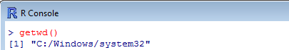
Working Directory
You can check your working directory using the getwd() function
In a R project it will be the root folder!
Notes:
Most of the time you will not be generating data in R but will be importing data from external files.
Before we can rerad in data, you need to know from what vantage point your R console is looking.
This view point is the working directory.

Slide 7
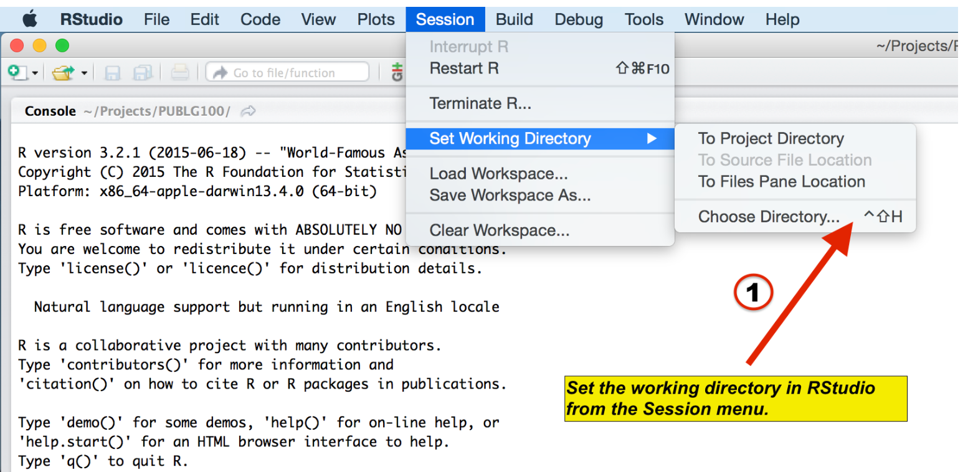
Setting the working directory
Your current working directory is usually your HOME directory
For projects, it’s best to keep everything in one folder:
input files
output files
scripts
Choose a working directory that’s easy to access
Let’s do this on the desktop:
Create a new folder called lecture_3
Open a new R script
Save the working directory to this folder
Session -> Set Working Directory -> Choose Directory
OR IN THE CONSOL
setwd("~/Desktop/lecture_3")
Notes:
Your currently working directory is typically your HOME directory.
When we do work on a project we typically want to keep everything in one place
i.e. input files, output files, scitps, etc.
it is also good to set your working directory where you can go into those folders easy.
We will do this in our desktop. Create a new folder and name it ‘lecture_3’

Slide 8
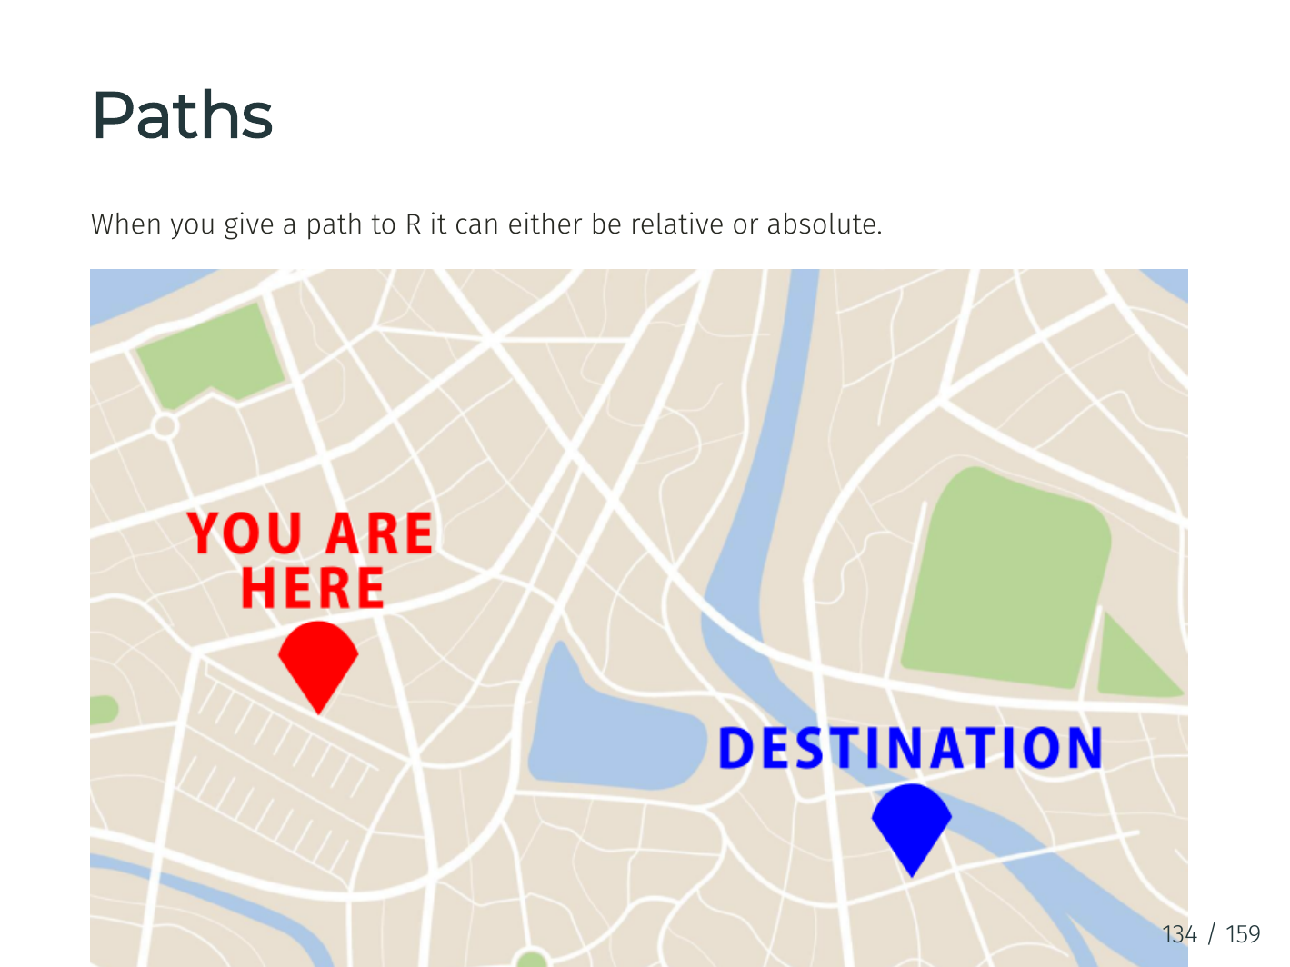
Paths
When you give a path to R it can either be relative or absolute

Slide 9
Paths
To use our map analogy:
Relative path are like directions i.e take a left, go straight then take a right etc. The context of whre you START is essential.
Absolute paths are like an address. They give you the final location in absence to any other external information
Both have their benefits

Slide 10
Paths in use
The command we used before was using an short hand ‘~’ of absolute path. The ‘~’ points to /Users/yourname
Absolute paths usually start with a ‘/’ to get to the top level of your computers file structure
Or use a relative path from your current working directory (e.g., if you're already in /Users/yourname):
setwd("~/Desktop/lecture_3")
setwd("/Users/yourname/Desktop/lecture_3")
setwd("Desktop/lecture_3")

Slide 11
Data from external sources
Now we have set our location we can start thinking about reading in data. A standard format for data is ‘.csv’ for tables like this:
Go to week 3 lecture material and download the zipped folder ‘Path_example’ and put it on your desktop

Slide 12
Data from text file with read.csv()
Tables from text files can also be read using the read.csv() function. This is a wrapper for read.table() with sep = "," already set.
read.csv() automatically uses sep = ",", ideal for comma-separated files
header = TRUE tells R the first row contains column names
Console Output
Table <- read.csv("Path_example/Raw data/gene_data.csv", header = TRUE)
Table[1:4, 1:3]
Gene_Name Sample_1.hi Sample_2.hi
1 Gene_a 4.570237 3.230467
2 Gene_b 3.561733 3.632285
3 Gene_c 3.797274 2.874462
4 Gene_d 3.398242 4.415202

Slide 13
Row names in read.csv()
read.csv() accepts the row.names argument to use a column as row names.
row.names = 1 uses the first column (Gene_Name) as the row names
Table <- read.csv("Path_example/Raw data/gene_data.csv", header = TRUE, row.names = 1)
Table[1:4, 1:3]

Slide 14
Setting factors from read.csv()
Like read.table(), read.csv() lets you control whether character data should be read in as factors using stringsAsFactors.
stringsAsFactors = FALSE is the default in R 4.0 and above
Prevents automatic conversion of text columns to factor variables
Other useful arguments:
skip — skip a number of lines when reading
comment.char — ignore lines starting with a given character
Table <- read.csv("Path_example/Raw data/gene_data.csv", header = TRUE, stringsAsFactors = FALSE)
Table[1:4, 1:3]

Slide 15
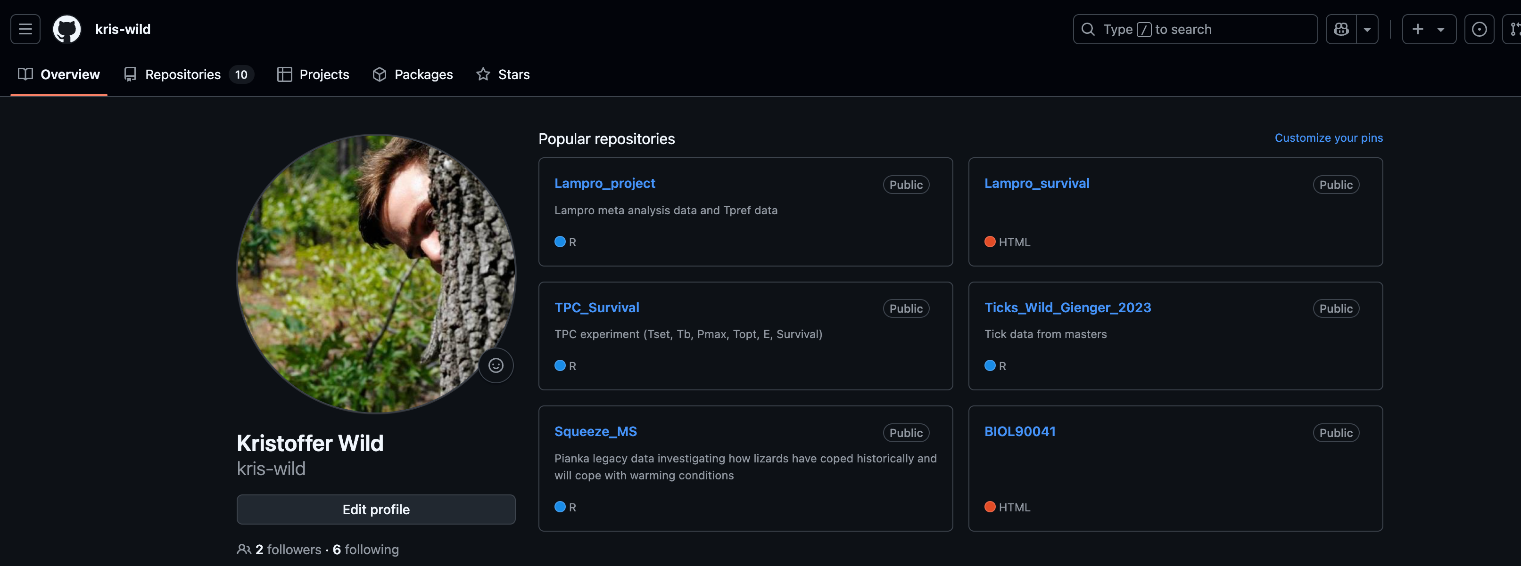
Reading data from outher sources
You can load data directly from GitHub using read.csv() — just make sure you link to the raw version of the file:
URL <- "https://raw.githubusercontent.com/kris-wild/TPC_Survival/main/R/Final.Analysis/Final.Figure.data/Field_Tb_vs_Tb_predict_SI.csv"
Table <- read.csv(URL, header = TRUE)
head(Table)

Slide 16

Class assignment (15 min)
JUST using using the ‘Path_example’ I want you to tell me…
how many .csv files are in there?
for each csv file tell me how many columns are character and numeric for each file
Now what if I want to back out of a file or go to a folder ‘behind’ my current directory
- Demo quick demo with Kris

Slide 17
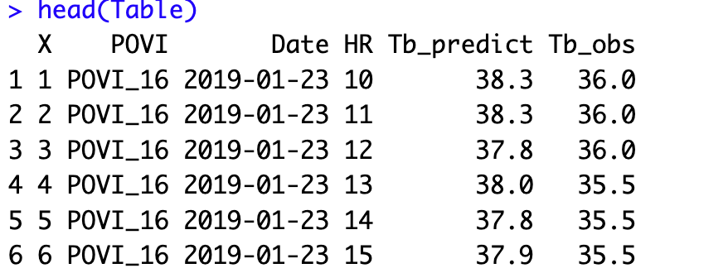
Reviewing your data
It is always important to know what your data is. Especially when you are reading it in for the first time. There are three functions to quickly use your data.
head()

Slide 18
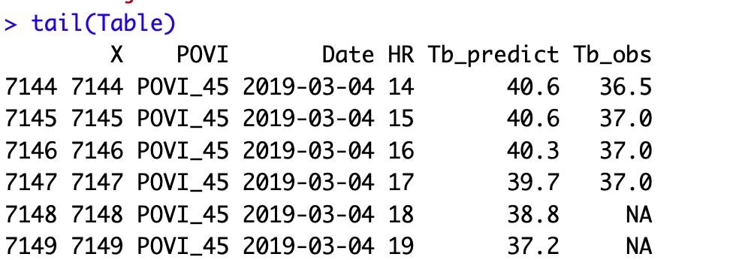
Reviewing your data
It is always important to know what your data is. Especially when you are reading it in for the first time. There are three functions to quickly use your data.
head()
tail()

Slide 19
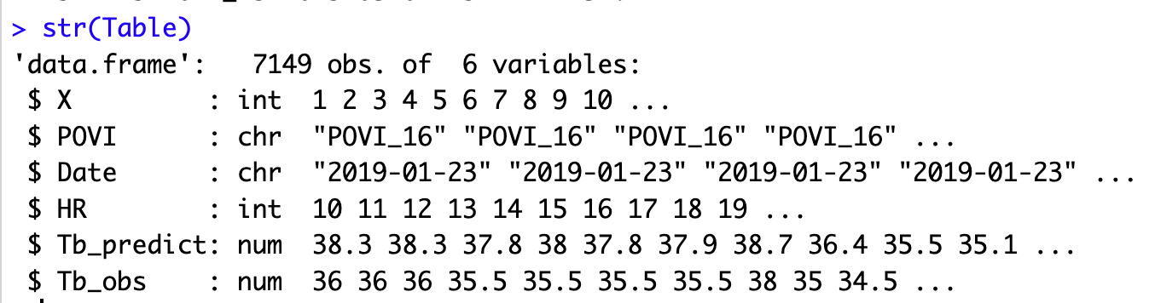
Reviewing your data
It is always important to know what your data is. Especially when you are reading it in for the first time. There are three functions to quickly use your data.
head()
tail()
str()

Slide 20
Saving Data with write.csv()
Save your data in a standard format (CSV) using write.csv()
Useful for:
Sharing data with others
Opening in Excel or other programs
Backing up cleaned datasets
Keep in mind:
Data types like dates and factors may lose formatting when reloaded
All columns become character or numeric upon re-import
Table <- read.csv('Path_example/Final data/not final yet/lizard.csv', header = TRUE)
write.csv(Table, file = ”data/my_data.csv", row.names = FALSE)

Slide 21
Saving R objects with saveRDS()
Save an entire R object exactly as-is using saveRDS()
To reload it later:
RDS files are great because:
They preserve object structure (e.g., factors, dates, models)
Compact and efficient for saving any R object
Perfect for saving data between script runs or analyses
Note: RDS files can only be read back into R, not into Excel or other programs
saveRDS(Table, file = "output/my_data.rds")
Table <- readRDS("output/my_data.rds")

Slide 22


Now you have your data!

Slide 23
“I spend more than half of my time integrating, cleansing and transforming data without doing any actual analysis. Most of the time I’m lucky if I get to do any ‘analysis’ at all…
… Most of the time once you transform the data ... the insights can be scarily obvious.”

Slide 24
“Once you play with the data you realize you made an assumption that is completely wrong. It’s really useful, it’s not just a waste of time, even though you may be banging your head.”
“In practice it tends not to be just data prep, you are learning about the data at the same time, you are learning about what assumptions you can make.”

Slide 25

Data Wrangling
Aka Data Prep, Data Munging, Data Transformation
Assessing and transforming raw data to make it fit for use
That depends!
Fit for what use?

Slide 26
Data Wrangling
Aka Data Prep, Data Munging, Data Transformation
Assessing and transforming raw data to make it fit for use
This is how you “get your head in the game”
Understand what you have
Assess strengths and weaknesses of your data
Hypothesise about what to do with your data
Get it ready
Nobody will know your data as well as you do while wrangling
Not even the “you” of a few days later

Slide 27
Discussion
When is data “dirty”?
How does that happen?
Notes:
Many possibilities here for discussion
Outliers
Misspellings
Type/constraint violations
Inconsistencies
Duplication
Missing data
Unusual distributions
Wrong granularity
Wrong time or other scope
Data entry
Measurement error
Bad data integration
Poor experimental design
Mismatch of data to task

Slide 28
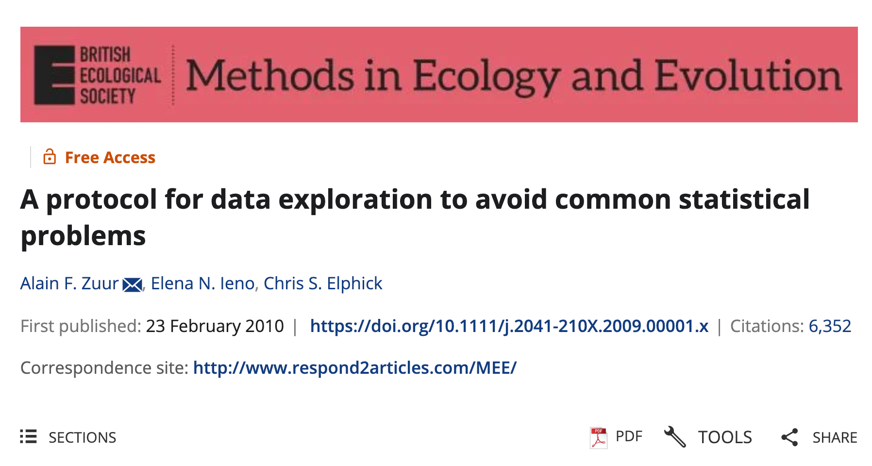
https://besjournals.onlinelibrary.wiley.com/doi/10.1111/j.2041-210X.2009.00001.x
Notes:
----- Meeting Notes (10/29/14 17:37) -----
FINISH ME!

Slide 29
Step 1 – Are There Outliers in Y or X?
Outliers are extreme values that differ from the rest of the data
They may arise from data entry errors, measurement errors, or real biological extremes
Outliers can skew visualisations, violate model assumptions, and bias results
"Outliers can dominate model outcomes or visualizations. Identifying them is essential before analysis.” - Zuur et al. (2010)

Slide 30
Step 1 – Are There Outliers in Y or X?
How would we look for outliers?
pacman::p_load(palmerpenguins, dplyr)
# Boxplot to detect outliers
boxplot(penguins$body_mass_g,
main = "Outlier Check: Body Mass (g)",
col = "lightgrey")
# Histogram to see distribution
hist(penguins$body_mass_g,
main = "Histogram of Body Mass (g)",
col = "skyblue")
Tip: Combine with summary() or sort()
to see extremes numerically.

Slide 31
Step 2 – Is the Variance Similar Across Groups?
Homogeneity means groups have a similar spread (variance).
Unequal variance can affect models like ANOVA or regression.
Can be visualized by comparing group distributions.
"Even moderate variance differences can degrade model reliability." — Zuur et al. (2010)

Slide 32
Step 2 in R – Check Variance (penguins)
How would we look for outliers?
# Compare body mass variance across species
boxplot(body_mass_g ~ species, data = penguins,
main = "Body Mass by Species",
col = c("lightblue", "lightgreen", "salmon"))
# Numerical check of variances
penguins %>%
group_by(species) %>%
summarise(var_mass = var(body_mass_g, na.rm = TRUE))

Slide 33
Step 3 – Are the Data Normally Distributed?
Normality refers to the bell-shaped curve in data distribution.
Histograms and QQ plots are used to inspect this.
Not all methods require normality, but it's important to check.
🗣 "Many methods are robust, but checking normality helps you choose the right approach." — Zuur et al. (2010)

Slide 34
Step 3 – Check Normality (penguins)
# Histogram of flipper length
hist(penguins$flipper_length_mm,
main = "Flipper Length Distribution",
col = "lightsteelblue")
# QQ plot (optional)
qqnorm(penguins$flipper_length_mm)
qqline(penguins$flipper_length_mm)
Tip: Look for symmetry and smooth tails in histograms.

Slide 35
Step 4 – Are There Lots of Zeros?
Excess zeros can distort models for count or binary data.
May require special modeling approaches.
Check both counts and joint absences (multivariate).
🗣 "Zero inflation requires special models or interpretation techniques." — Zuur et al. (2010)

Slide 36
Step 4 –Check Zeros (penguins)
# Create a binary variable
penguins$heavy <- ifelse(penguins$body_mass_g > 4500, 1, 0)
# Check frequency of 0s and 1s
table(penguins$heavy)
# Visualize
barplot(table(penguins$heavy),
main = "Binary Variable: Heavy (>4500g)",
col = "gold")

Slide 37
Step 5 – Are the Predictors Too Similar?
Collinearity occurs when two or more predictors are strongly correlated.
This can inflate standard errors and mask variable importance
Use correlation matrices or visual tools to detect it.
"Collinearity reduces model interpretability and power.” — Zuur et al. (2010)

Slide 38
Step 5 in R – Check Collinearity (penguins)
# Prepare numerical data
num_vars <- penguins %>%
select(bill_length_mm, bill_depth_mm, flipper_length_mm, body_mass_g) %>%
filter(if_all(everything(), ~ !is.na(.)))
# Correlation matrix
cor(num_vars)
# Visualise correlation
pacman::p_load(corrplot)
corrplot(cor(num_vars), method = "circle")

Slide 39
Step 6 – What Is the Relationship Between Y & X?
Helps identify if a linear model is appropriate, or if relationships are nonlinear.
Can reveal thresholds, curvatures, or outliers.
Always plot your response variable vs. each predictor.
"Scatterplots can reveal patterns that inform model design."— Zuur et al. (2010)

Slide 40
Step 6 in R – Plot Y vs. X (penguins)
# Base R scatterplot
plot(flipper_length_mm ~ body_mass_g,
data = penguins,
main = "Flipper Length vs. Body Mass",
col = "darkblue", pch = 19)

Slide 41



A basic R project set up
Week_2
Week_2.Rproj
Data
Quarto (.qmd)
Script
Lecture_script.R
Output
Plots
Lecture

Slide 42
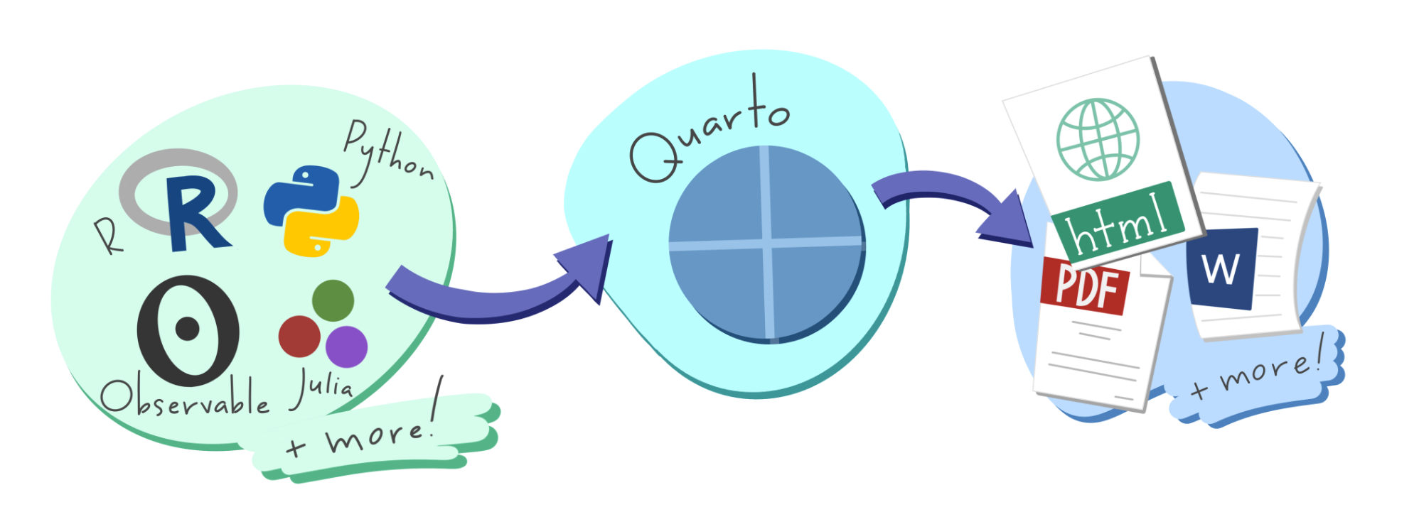

What is Quarto?
An open-source tool that seamlessly integrates code, results, and narrative text into a single document
Key Features:
Multi-language Support: Works with R, Python, Julia, and more.
Versatile Outputs: Generate reports, presentations, websites, and dashboards in formats like HTML, PDF, and Word.
Reproducibility: Ensures that analyses are transparent and reproducible by embedding code and its output directly within the document
Use Cases:
Communication: Present findings to stakeholders with clear narratives and visualisations.
Collaboration: Share comprehensive analyses with peers, including code and results.
Documentation: Maintain a detailed record of data analysis processes and decisions.
Integration:
Fully compatible with RStudio and other IDEs, providing a user-friendly interface for creating and rendering documents.

Slide 43
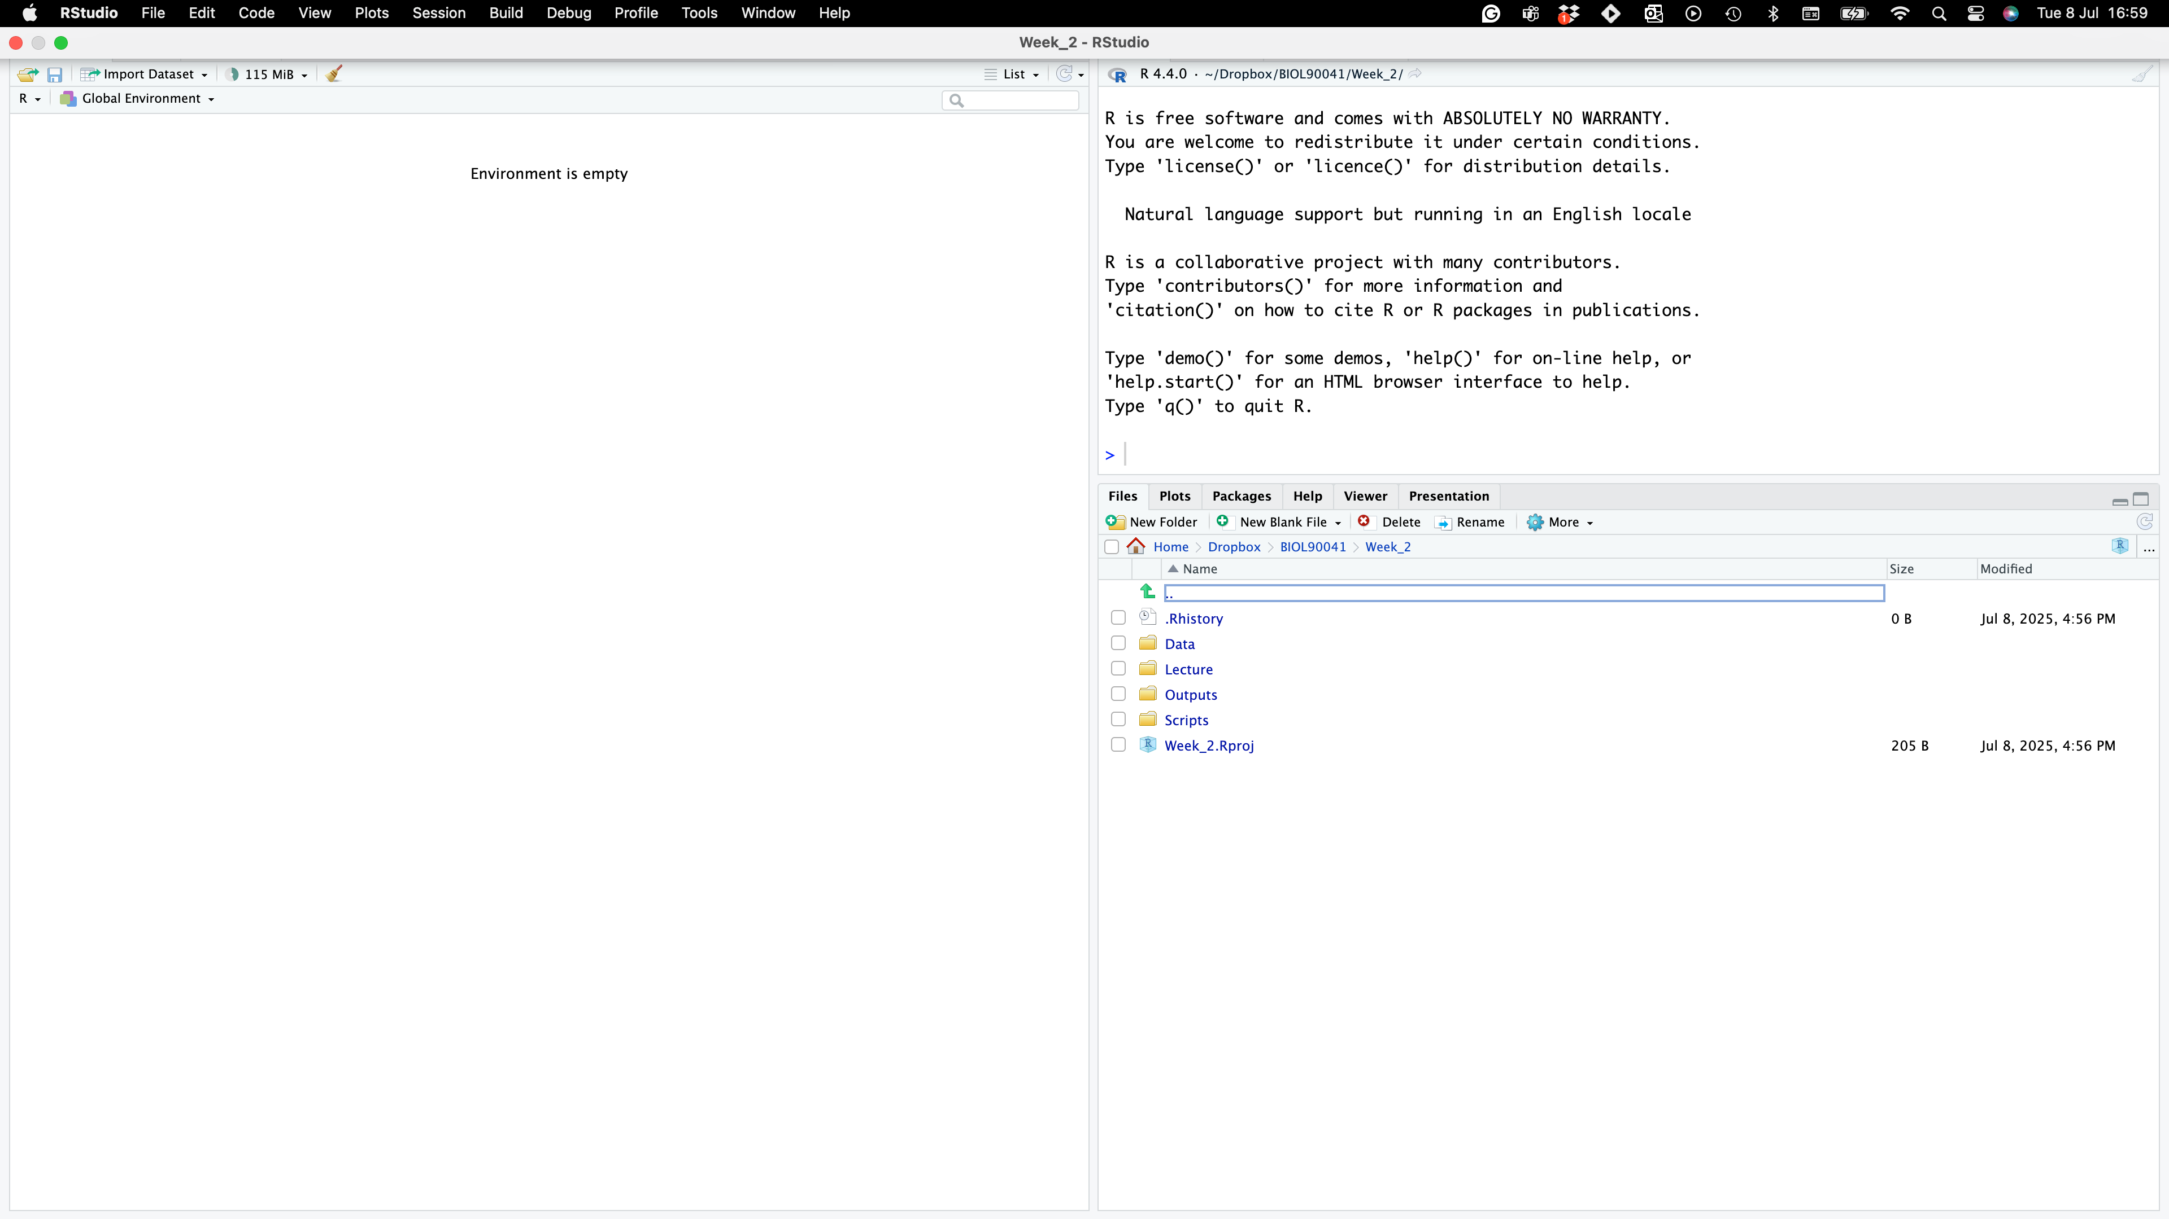

Where to find it?
Project name
NO SCRIPT?!?!!
Project folders

Slide 44
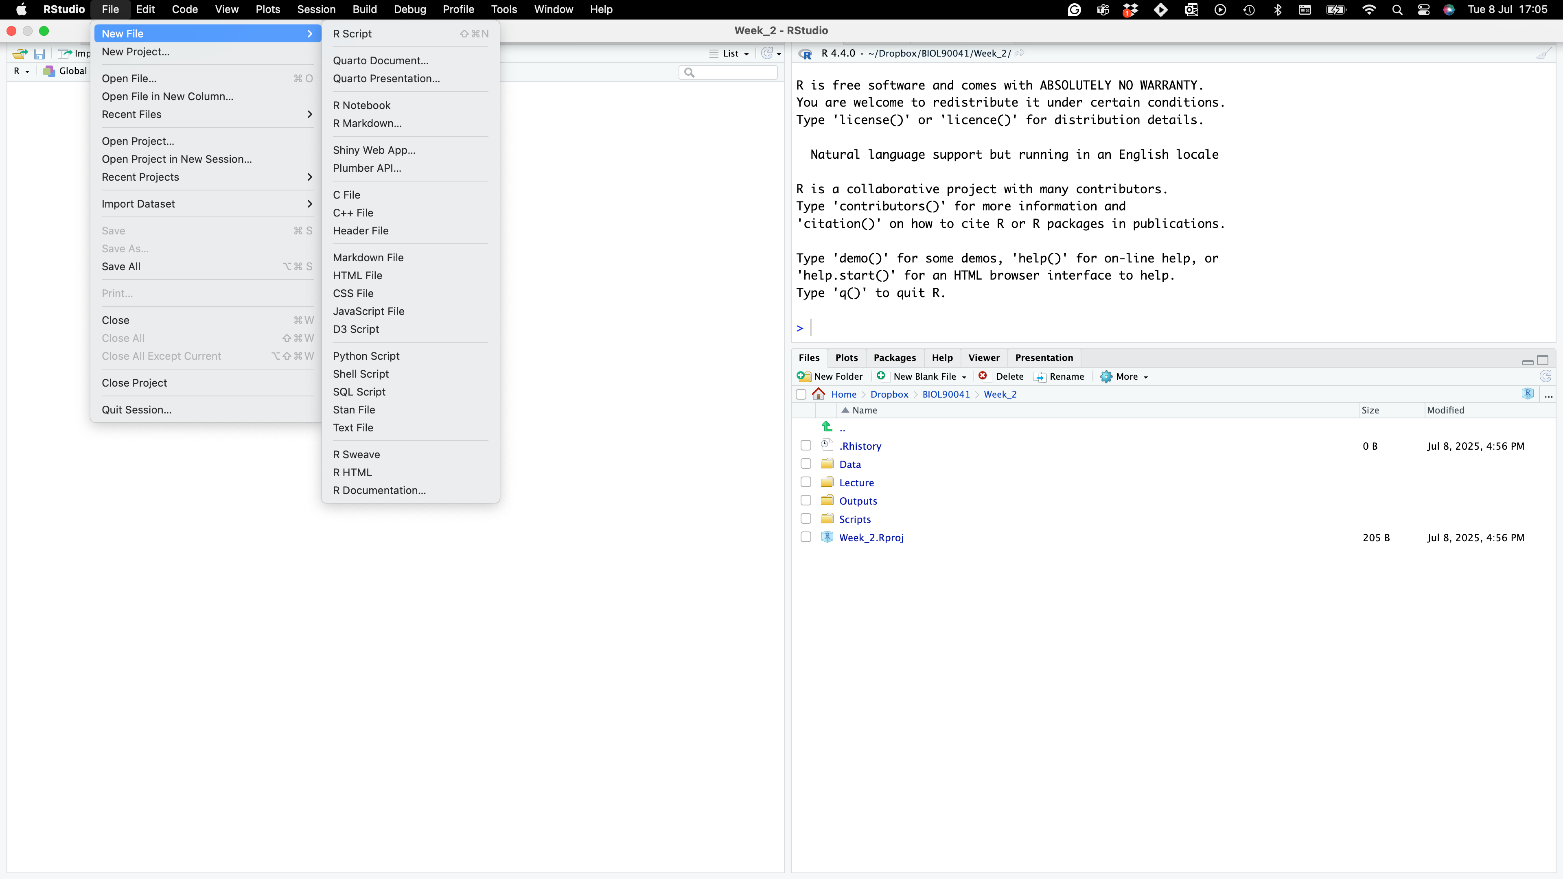
Where to find it?
NO SCRIPT?!?!!

Slide 45
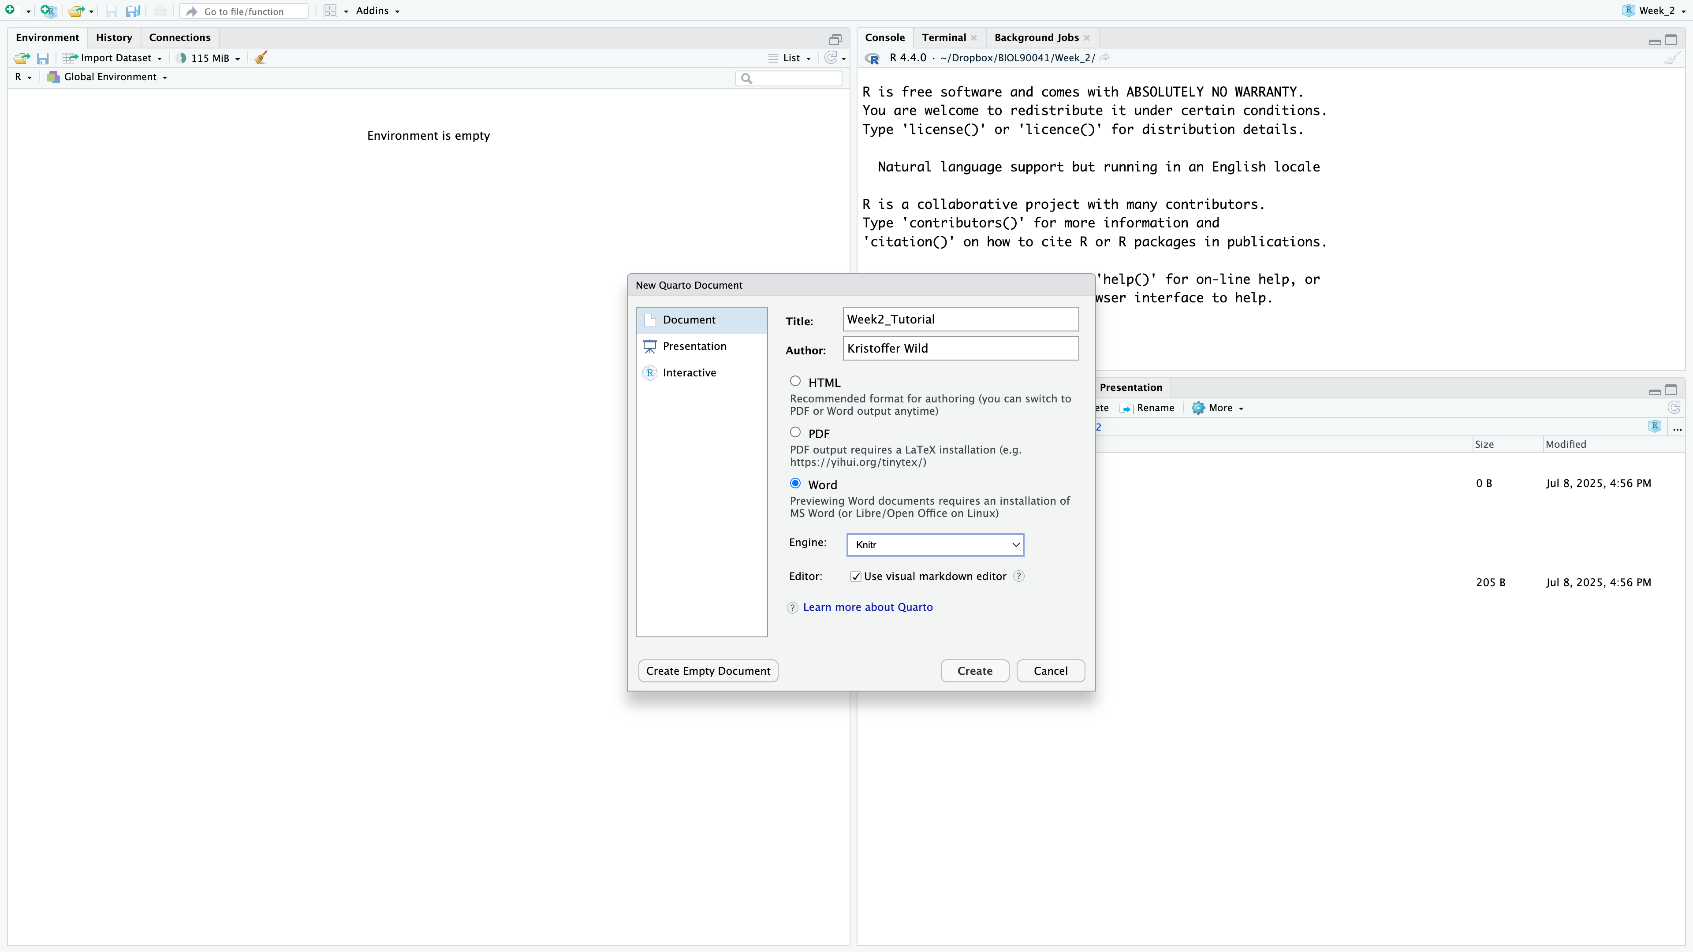
Where to find it?
NO SCRIPT?!?!!

Slide 46
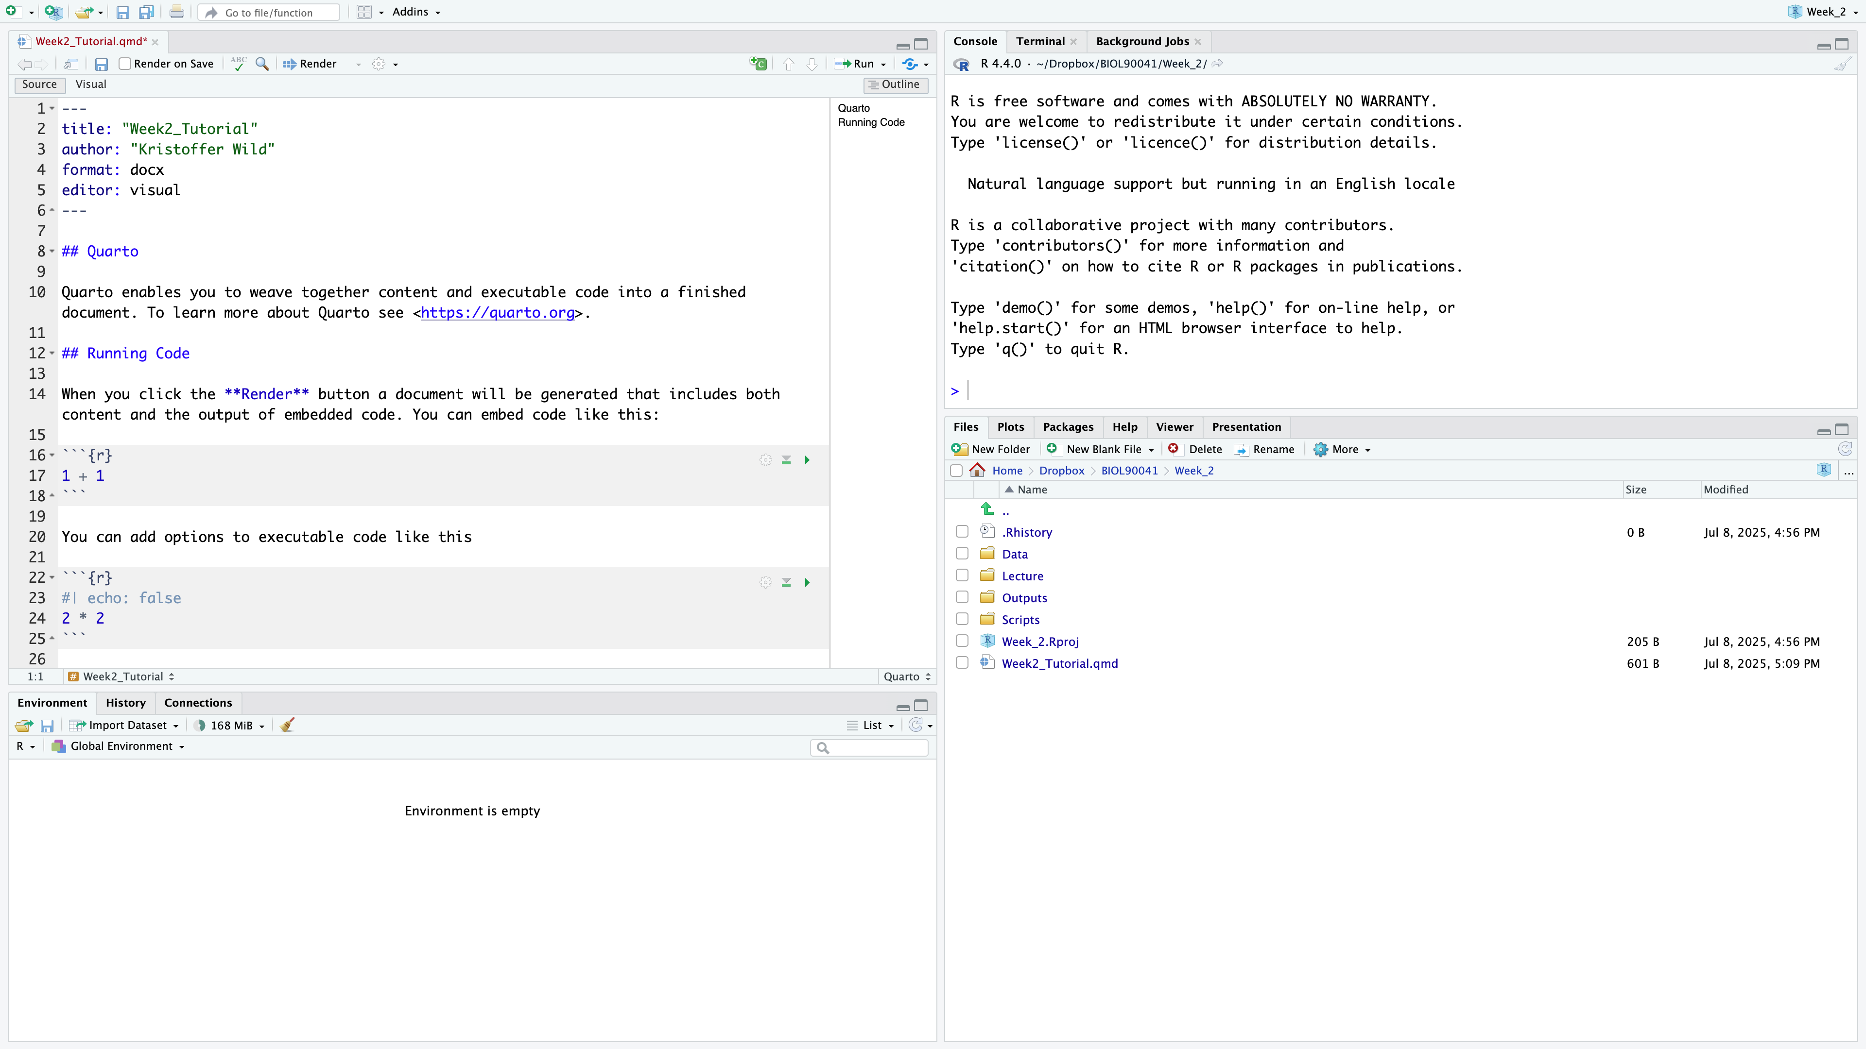
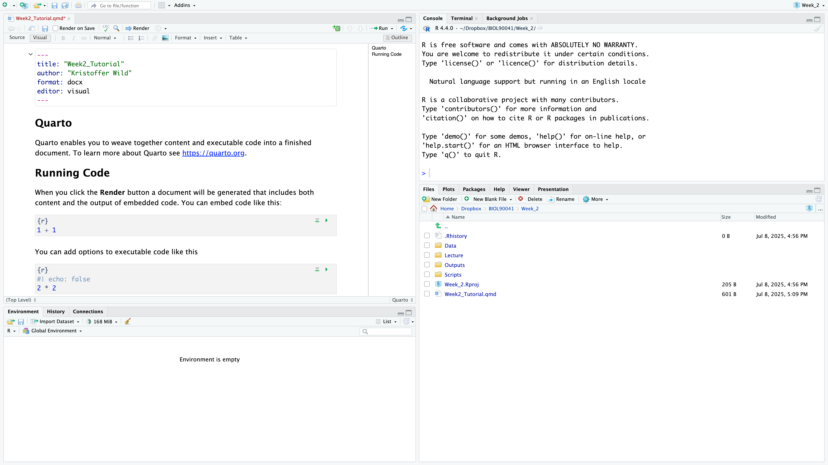
Where to find it?
Metadata
LINE #’s
NO SCRIPT?!?!!
Notes:
I saved my file as ‘Week2_tutorial.qmd’, for those of you that are use to markdown notice that the suffix has changed (rmd to qmd).
At the top of the document you will have some metadata on the document: title, format (word doc), editor….
The editor is a pretty awesome feature that you wouldn’t get in a markdown document. Here you can get the look of
what it would look like in a word document.

Slide 47
Where to find it?
Text
Text headings
Code ‘Chunks’
NO SCRIPT?!?!!
Notes:
I saved my file as ‘Week2_tutorial.qmd’, for those of you that are use to markdown notice that the suffix has changed (rmd to qmd).
At the top of the document you will have some metadata on the document: title, format (word doc), editor….
The editor is a pretty awesome feature that you wouldn’t get in a markdown document. Here you can get the look of
what it would look like in a word document.

Slide 48
Where to find it?
Check out the tool bar : change text formatting and see how source code changes!
NO SCRIPT?!?!!
Notes:
Now play with the tool bar
you can bold, italicize text
you can add in links
Change the formatting headings
If you go back to the source code you can see what it’s doing under the hood.
Here if you used markdown in the past, you would have to know this laytext code

Slide 49
Quarto live DEMO with Kris
Here we will go over…
setting up metadata to render into a word document
formatting code chunks
how code should be in code chunks
practicing writing results under code chunks
rendering document with appropriate code, plots, and write up

Slide 50
Next week…
But first…reminder we have a workshop this week!
Wednesday, 11-1 at PAR125-L1-Room 127 (WEBS)
Next week we will cover:
summarise
gsub
stringr
merging
joining

